Slide 1
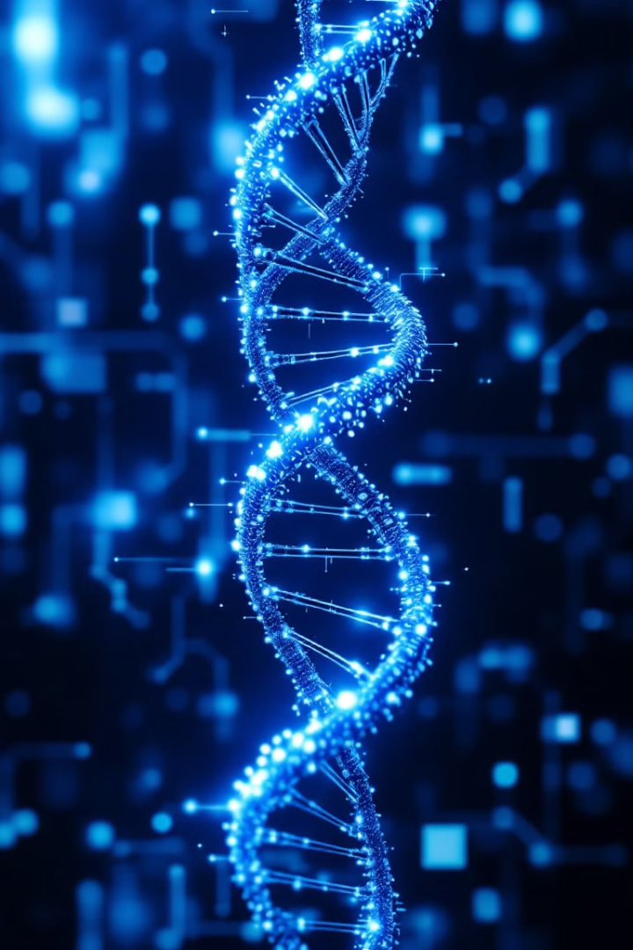
Hardware Accelerator for DNA Local Sequence Alignment
Author: Eliyahu Wiener
Supervisor: Zuher Jashan
VLSI LAB
Winter 2025

Slide 2
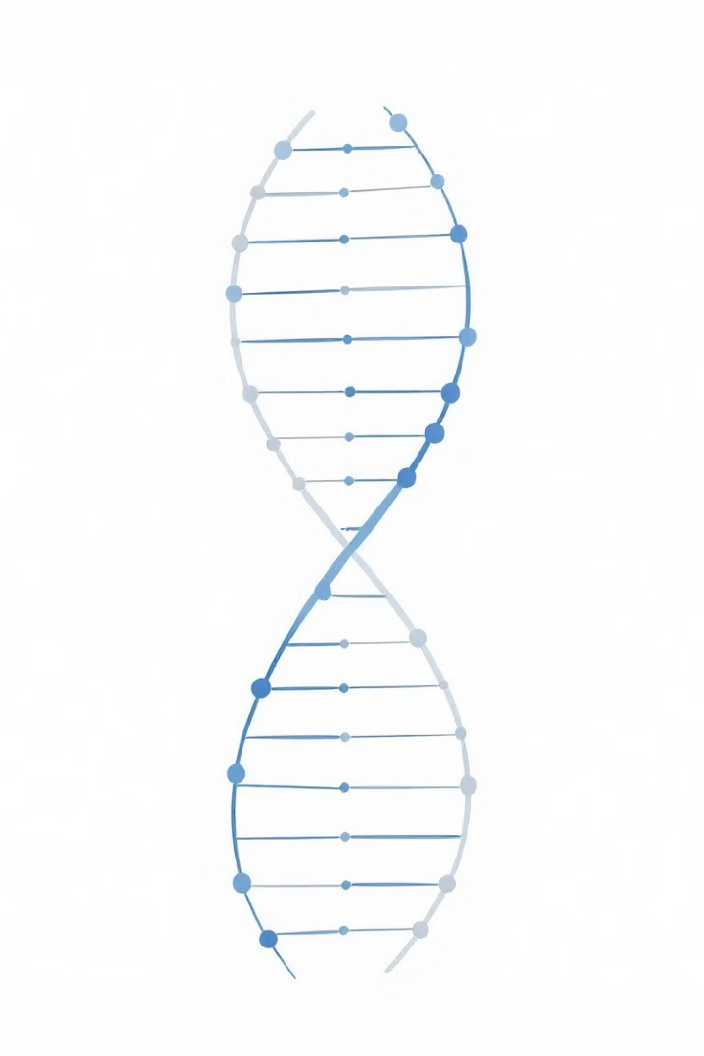
General Information
What is Sequence Alignment?
Comparing (ordering) DNA, RNA, or protein sequences
Identifies regions of similarity
Used in bioinformatics for evolutionary studies and gene function prediction

Slide 3
Global vs Local Alignment
Global Alignment:
Compares entire sequences
Best for sequences of similar length
Example: Needleman-Wunsch Algorithm
Local Alignment:
Finds regions of high similarity within sequences
Best for analyzing genetic variations and functional domains
Example: Smith Waterman Algorithm

Slide 4

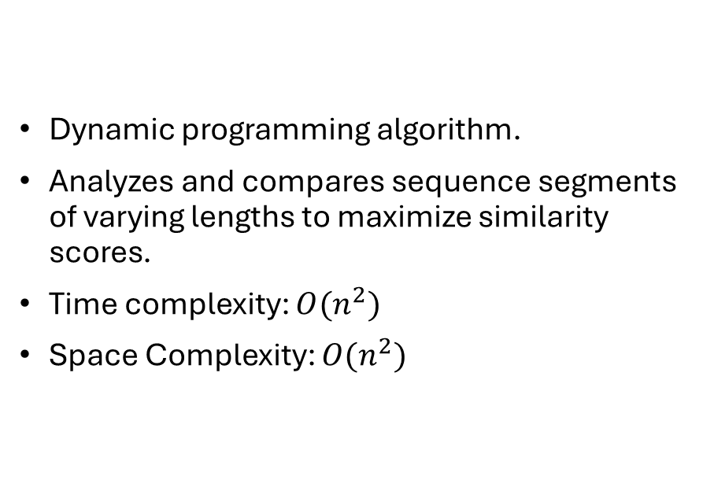
Smith Waterman Algorithm
Dynamic programming algorithm.
Analyzes and compares sequence segments of varying lengths to maximize similarity scores.
Time complexity: $O(n^{2})$
Space Complexity: $O(n^{2})$

Slide 5
Smith Waterman Algorithm Steps
Step 1: Initialization
Create a scoring matrix with rows and columns for both sequences.
First row and first column are initialized to zero.
Step 2: Matrix Scoring
Assign scores for matches, mismatches, and gaps.
The formula:
Match: +1
Mismatch: -1
Gap Penalty: -2
Step 3: Traceback
Start from highest scoring cell in the matrix.
Trace back until reaching a zero score.
Reconstruct the best alignment.

Slide 6
Smith Waterman Algorithm

Slide 7
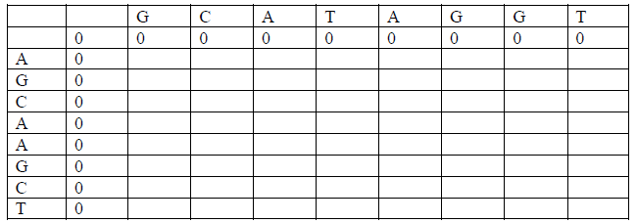
Smith Waterman Algorithm - Example
Step 1: Initialization

Slide 8
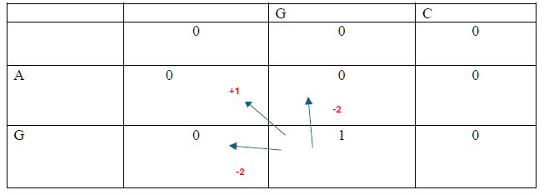
Smith Waterman Algorithm - Example
Step 2: Matrix Scoring

Slide 9
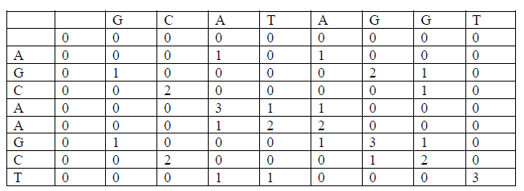
Smith Waterman Algorithm - Example
Step 2: Matrix Scoring

Slide 10
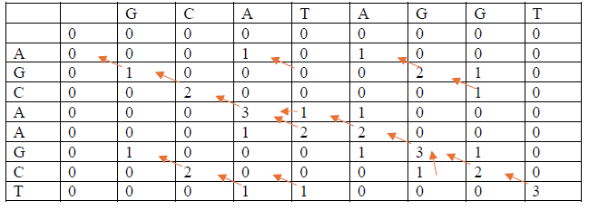
Smith Waterman Algorithm
Step 3: Traceback

Slide 11
Smith Waterman Algorithm
Step 3: Traceback
Alignment 1 Alignment 2 Alignment 3
GCA GCATAG GCATAGGT
GCA GCA-AG GCA-AGCT

Slide 12


Motivation – Why Hardware Acceleration?
Challenges in Sequence Alignment
1. Large genomic datasets
require significant computational power.
2. Software solutions
(e.g., running Smith-Waterman on CPUs) are too slow.
3. Millions of alignments
may be needed in bioinformatics databases.

Slide 13

Motivation – Why Hardware Acceleration?
Why Hardware?
1. Faster processing
by leveraging parallelism.
2. Reduces bottlenecks
in computing large sequences.
3. Improves efficiency
by offloading computation to specialized hardware

Slide 14
Solutions
Manual Alignment: Simple but impractical for large sequences
Software-Based Dynamic Programming: Accurate but computationally expensive
Heuristic & Probabilistic Algorithms: Fast but less accurate
Hardware Accelerators: Best balance of speed, efficiency, and accuracy

Slide 15
Chosen Solutions Principles
Smith-Waterman Algorithm implemented in hardware
Parallel processing to improve speed
Dedicated hardware accelerator reduces computational overhead
Time Complexity: O(n)
Space Complexity: O(n²)

Slide 16
Top Design

Slide 17
General Architecture

Slide 18
General Architecture
Processing Strategy:
Tile-based computation
Parallel processing for efficiency

Slide 19
Data Representation
Input Encoding:
A = 00, T = 01, C = 10, G = 11
Output Encoding (Including Gaps):
A = 000, T = 001, C = 010, G = 011, Gap = 100

Slide 20
Processing Flow
Input Sequences (256 characters each)
Scheduler Divides Matrix into Tiles (16×16)
Parallel Computation:16 Solver Units process tiles concurrently
Organizer Collects Results
CIGAR Builder Constructs Final Alignment

Slide 21
Block Level Diagram - Scheduler
Distributes sequence data to solvers

Slide 22
Block Level Diagram - Solver
Compute Smith-Waterman scoring

Slide 23
Block Level Diagram - Organizer
Manages results, tracks global max score

Slide 24
Block Level Diagram - RAM
Stores intermediate data

Slide 25
Block Level Diagram - CIGAR Builder
Performs traceback and constructs the alignment

Slide 26

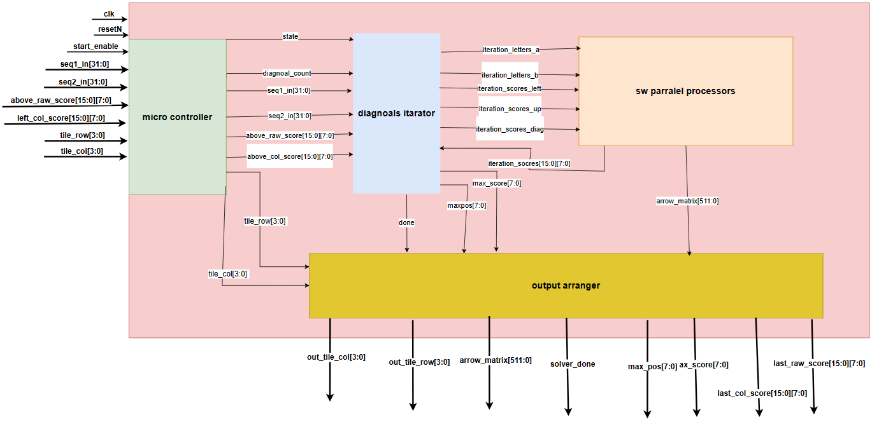
HDL Implementation – Solver
Components:
State Machine (IDLE, INIT, PROCESS_DIAG, FINALIZE)
Data Structures:
Score Matrix
Arrow Matrix
Processing Algorithm:
Match/Mismatch Scoring
Gap Penalty Application
Traceback Computation

Slide 27

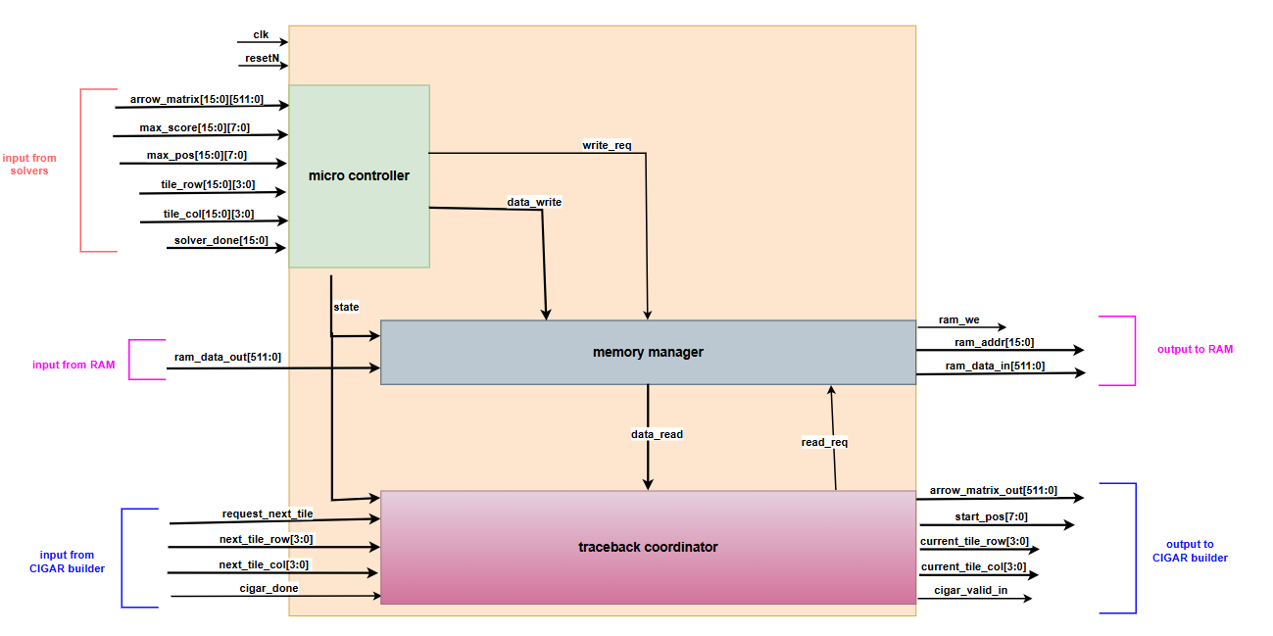
HDL Implementation – Organizer
Functionality:
Collects solver results
Tracks max score
Stores data in RAM
Manages traceback coordination

Slide 28

Simulating the Solver
Testbench Setup:
Clock and reset signals initialization.
Input test cases for sequences and scores.
Validation of:
Correct alignment generation.
Proper score calculation.
Timing constraints compliance.

Slide 29

Simulating the Organizer
Test Scenarios:
RAM read/write tests.
Solver interactions:
Handling multiple solver completions.
CIGAR Builder interface:
Verifies correct traceback reconstruction.

Slide 30
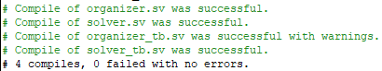
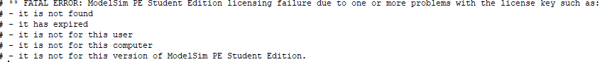

Slide 31

Uncomplete tasks and Further Work
Saving trace per tile
Streaming the input
Addressing the memory
Simulations results visualization
Synthesis of the HDL Implementation
Layout
Comparing performance – hardware vs software

Slide 32
Conclusions
Hardware accelerators provide a faster, more efficient way to align DNA sequences.
Designing for parallelism and concurrency is crucial.
The Smith-Waterman algorithm benefits from dedicated hardware execution.
This project demonstrates how hardware acceleration can enhance bioinformatics applications.

